Slide 1
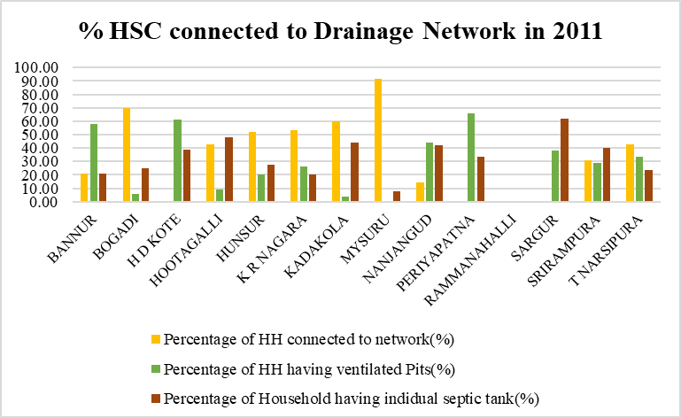
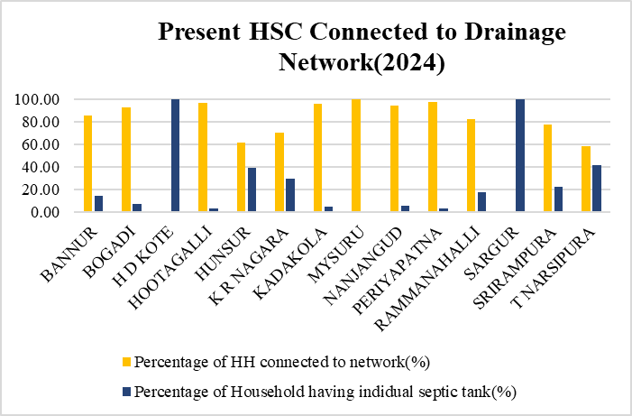
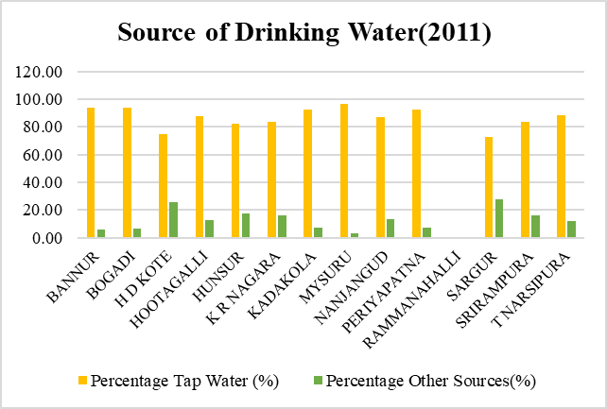
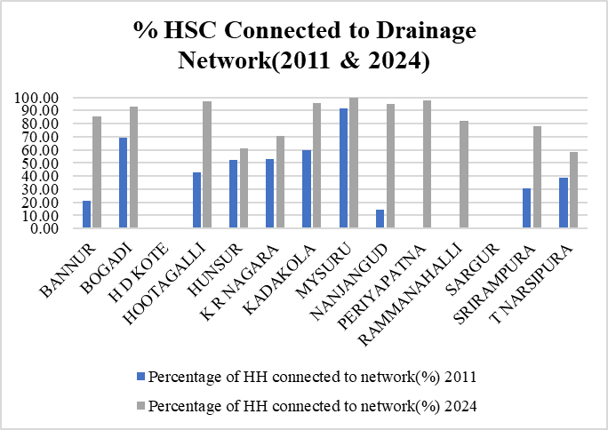
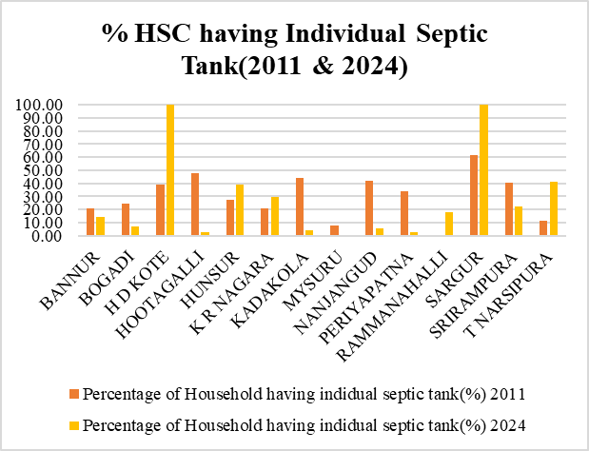
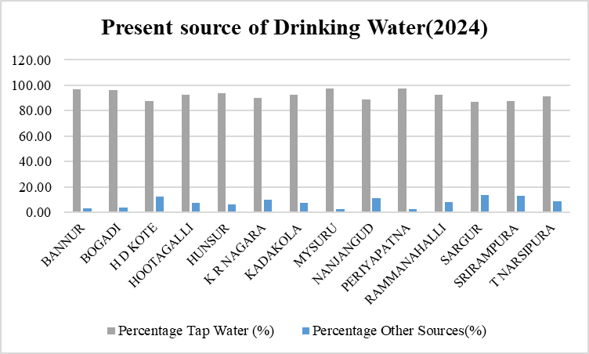
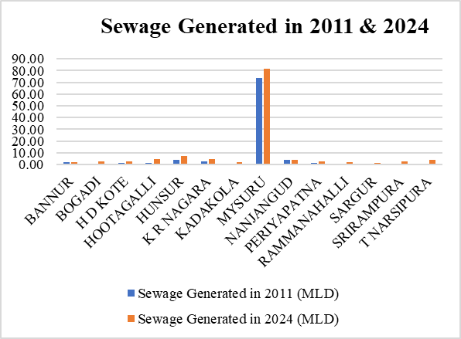
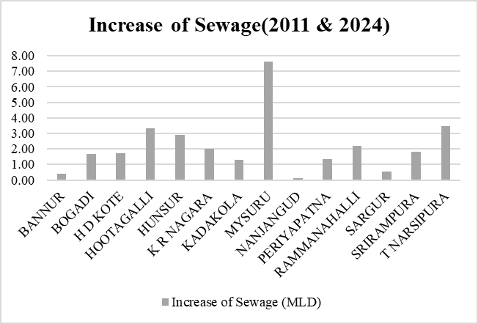
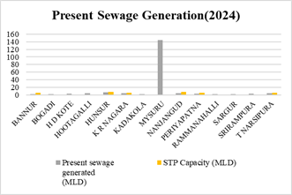
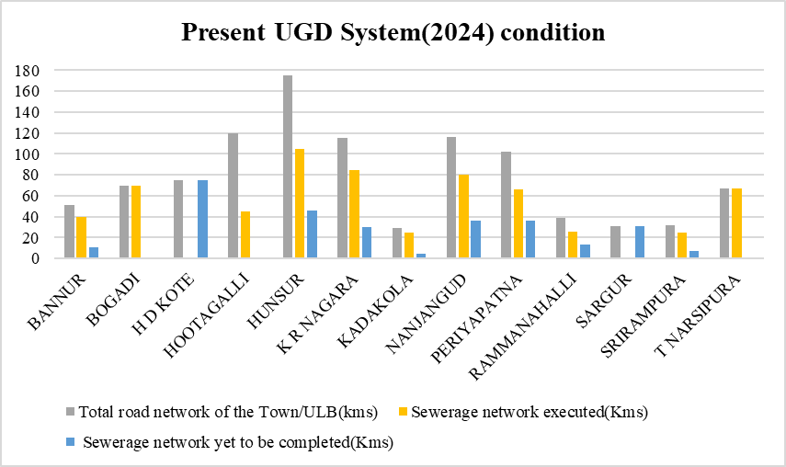
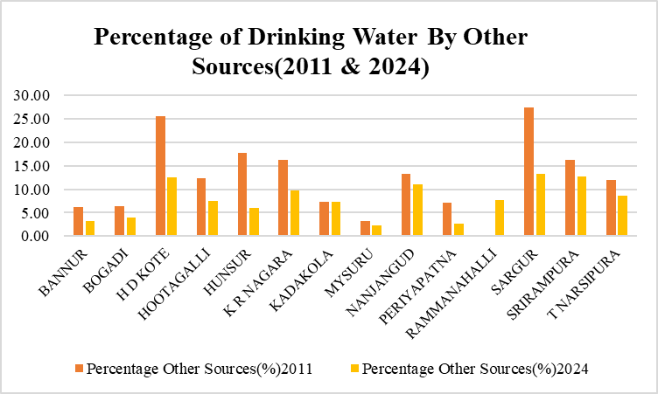
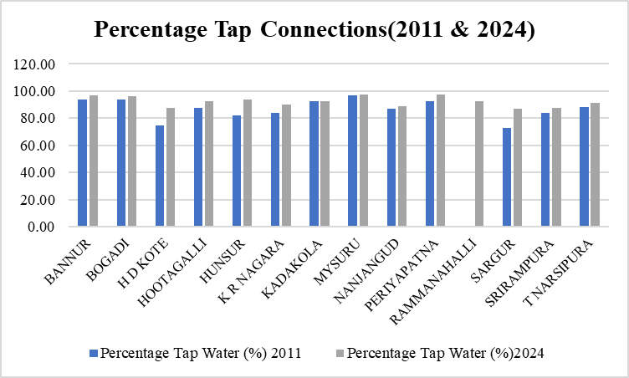
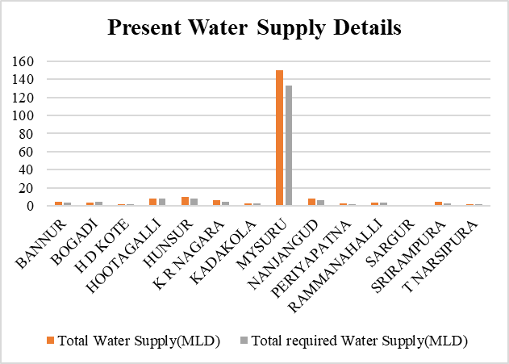
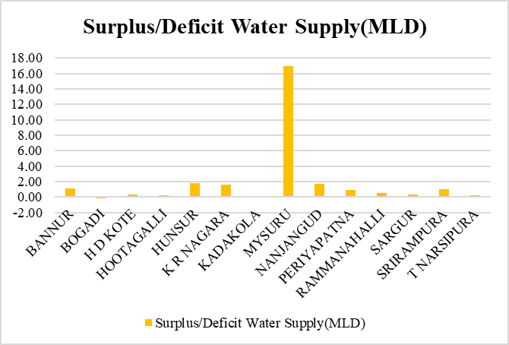
1.WATER SUPPLY
2.SEWAGE GENERATION
URBAN CORE INFRASTRUCTURE
1. Water Supply:
River Kaveri is the main source of drinking water supply.
Almost all the towns depend directly on river (direct pumping, infiltration galleries, shallow wells in the river bed etc) during low flow season, the water supply is supplemented by groundwater.
The Kaveri water quality is classified as Category “C” Drinking water source after conventional treatment and disinfection in the upstream of town where the intake is situated.
However, in the down steam, due to discharges from various industries and sewage from different areas of Mysore , the water quality on the downstream side is poor.
Water Supply Schemes:
1.Jaladhare Program: To provide surface water-based drinking solutions.
Multi-village water supply schemes (MVS) sourcing water from rivers and reservoirs, like the Kaveri River, treating it, and delivering it to multiple villages.
SVS (Single Village Scheme):Designed for villages with sufficient local water resources .Provides piped water supply to individual households within a single village.
2.Urban Water Treatment Plants:
Mysore city has water treatment plants at Belagola, Melapura, and Hongalli that manage raw water from the Kaveri River.
These plants ensure treated water meets safety standards for drinking, even amidst seasonal variations in water quality
3.Jal Jeevan Mission:
Integrated with rural areas, this mission aims for 100% household tap connections, prioritizing safe and piped water for drinking
2. Sewage Generation:
There is no working underground drainage system in H D Kote & Sargur
The system of soak pits and septic tanks are used for the disposal of sewage in the city.
In H D Kote, The sewage from the city is collected through open drains, Septic Tanks and let into Nalas which is eventually joining Kabini River
In Sargur, The sewage from the city is collected through open drains, Septic Tanks and let into Nalas which is eventually joining Nagu River Downstream.
Bogadi,Srirampura,Kadakola,Ramanahalli,Hootagalli doesn’t have STP hence the Sewage is treated by Mysore’s 3 STPs
SCHOOL OF PLANNING AND ARCHITECTURE
NAME: MAHAM KAUSAR
REV/EXM:02
DISTRICT DEVELOPMENT PLAN FOR MYSURU DISTRICT
CLASS:3rd Sem, MTech in URP
DRW:02
REG NO:P01ZZ23T107004

